Slide 1
Mechanica: Rocket science
Sam Motmans

Slide 2
Rocket height measurement
Principles & Methods
Electronic hardware & software
Data structure & example

Slide 3
Principles & Methods
Height measurement?
Accellerometer?
Gyroscope?
Altimeter?
Gyroscope + Accellerometer?
Altimeter + Accellerometer?

Slide 4

Accellerometer
Measures acceleration of object
Measurements at steady intervals
Possible to acquire velocity
In function of time

Slide 5

Gyroscope
Measures orientation of object
No measurements of displacement of object
In function of time

Slide 6

Altimeter
Measures height of object
Barometric sensor
Measures pressure
Height calculated via pressure

Slide 7
Accelerometer+ Gyroscope
Measures acceleration & orientation of object
Problems with this method?
If object starts rotating around it’s axis it introduces acceleration in all directions. → Height can not be estimated correctly

Slide 8
Altimeter + Accelerometer
Measures height and acceleration of object
Height in function of time
Acceleration in function of time
X, Y, Z Displacement can be calculated

Slide 9
Electronic hardware & software
Components
Espressif-ESP32 Microcontroller
MMA8451Q Accelerometer
MPL3115A2 Altimeter
Specs
Operating voltage: 2.6v – 3.6V
Weight : ~40g

Slide 10
Electronic hardware & software: Datasheets
Espressif-ESP32 Microcontroller
https://www.espressif.com/sites/default/files/documentation/esp32-wroom-32e_esp32-wroom-32ue_datasheet_en.pdf
MMA8451Q Accelerometer
https://www.nxp.com/docs/en/data-sheet/MMA8451Q.pdf
MPL3115A2 Altimeter
https://www.nxp.com/docs/en/data-sheet/MPL3115A2.pdf

Slide 11
Electronic hardware & software: Schematic

Slide 12
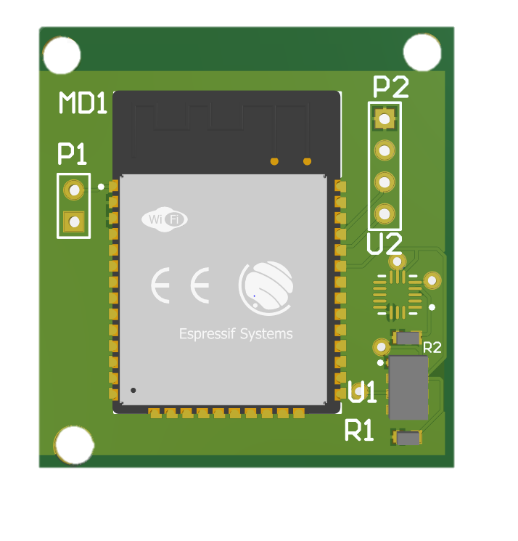
Electronic hardware & software: PCB

Slide 13
Electronic hardware & software
Language driver C++
Language dashboard/ parser: Python
See attachment
https://github.com/MotmansS/ROCKETSCIENCE

Slide 14
Data structure & example
Data structure: .CSV FORMAT
Comma separated value
Height , accel_x, accel_y, accel_z

Slide 15
Data structure & example

Slide 16
Rocket Science
Place the circuit board as seen fit in your design
Read out the data and visualize to see the height trajectory of the rocket
* Utilize acceleration and height data to get x, y, and z directions of the trajectory.
Visualize this data

Slide 17
Mechanica: Rocket science
Sam Motmans

